Slide 1

Social Media Analysis
Mr. Ayush Porwal
06/02/2025

Slide 2
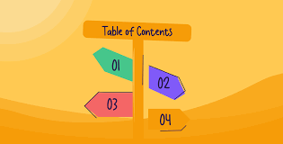
About Meta
Problem Statement
Schema
Data Overview
Approach
Key Metrics
User Classification
Avg. Likes for Tags
TOP engaged user based on likes comments and followers
Likes Comments and Tags of each users
Recommendation
Conclusion

Slide 3
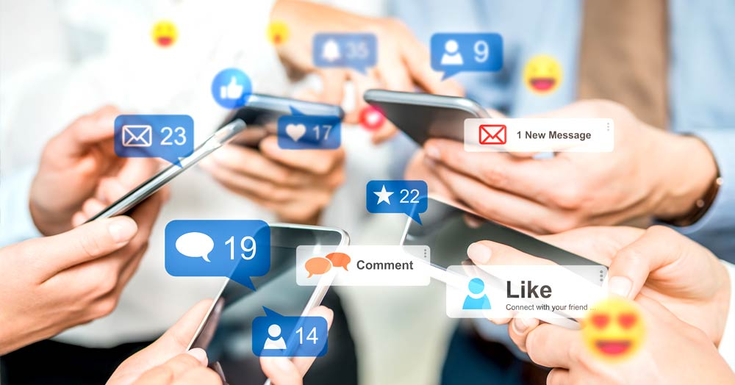
About META
Meta Platforms Inc. (formerly Facebook) is a global technology company focused on building the future of digital connectivity through social media, artificial intelligence, and virtual reality. Founded by Mark Zuckerberg in 2004, Meta owns some of the world’s most popular platforms, including Facebook, Instagram, WhatsApp, and Messenger, with a combined user base of over 3 billion people. The company is heavily investing in AI, augmented reality (AR), and virtual reality (VR) through its Reality Labs division, aiming to create immersive experiences and shape the future of the metaverse. With innovations like the Meta Quest VR headsets and advancements in AI-driven content and advertising, Meta continues to revolutionize digital interaction and redefine the way people connect globally.

Slide 4
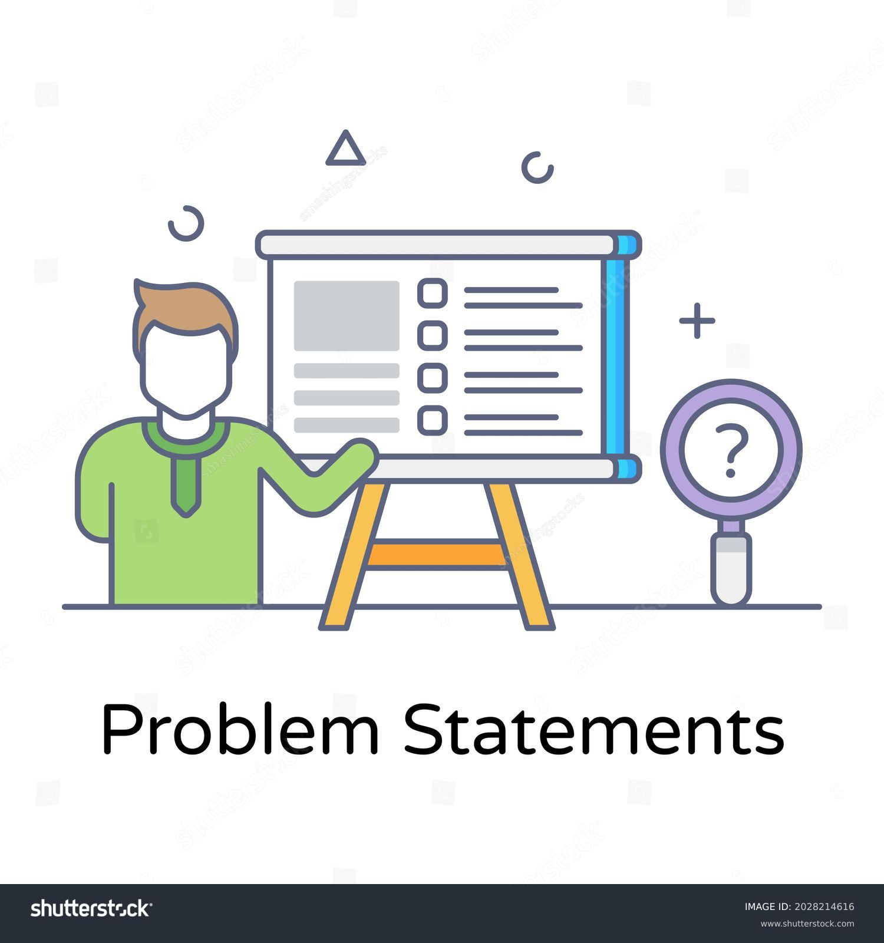
Problem Statement:
You are hired as a data analyst at Meta and asked to collaborate with Marketing team. Marketing teams wants to leverage Instagram's user data to develop targeted marketing strategies that will increase user engagement, retention, and acquisition. Provide insights and recommendations to address the following objectives

Slide 5

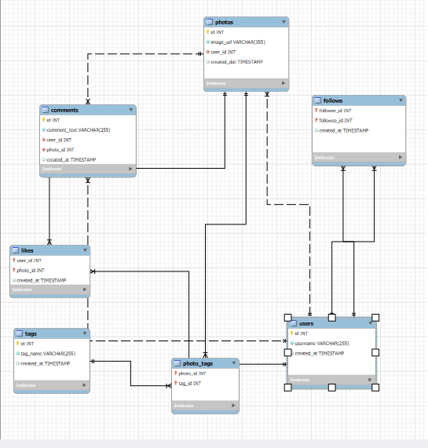
SCHEMA

Slide 6

Data Overview
Dataset Summary:
The dataset represents an Facebook-like social media platform and includes user activity data such as posts, comments, likes, follows, and tags. It helps analyze engagement trends and user behavior.
Key Data Points:
User Activity: Tracks users, their posts, likes, and comments.
Engagement Metrics: Number of likes, comments, and follows.
Content Categorization: Uses tags to classify photos.
Social Graph: Captures user connections through follows.
The dataset contains 7 tables: users, comments, likes, photos, photo tags, tags, and follows.
Total number of users: 100.
Total posts made so far: 257.
Total posts made so far: 257.
Total comments on all posts: 7,488

Slide 7
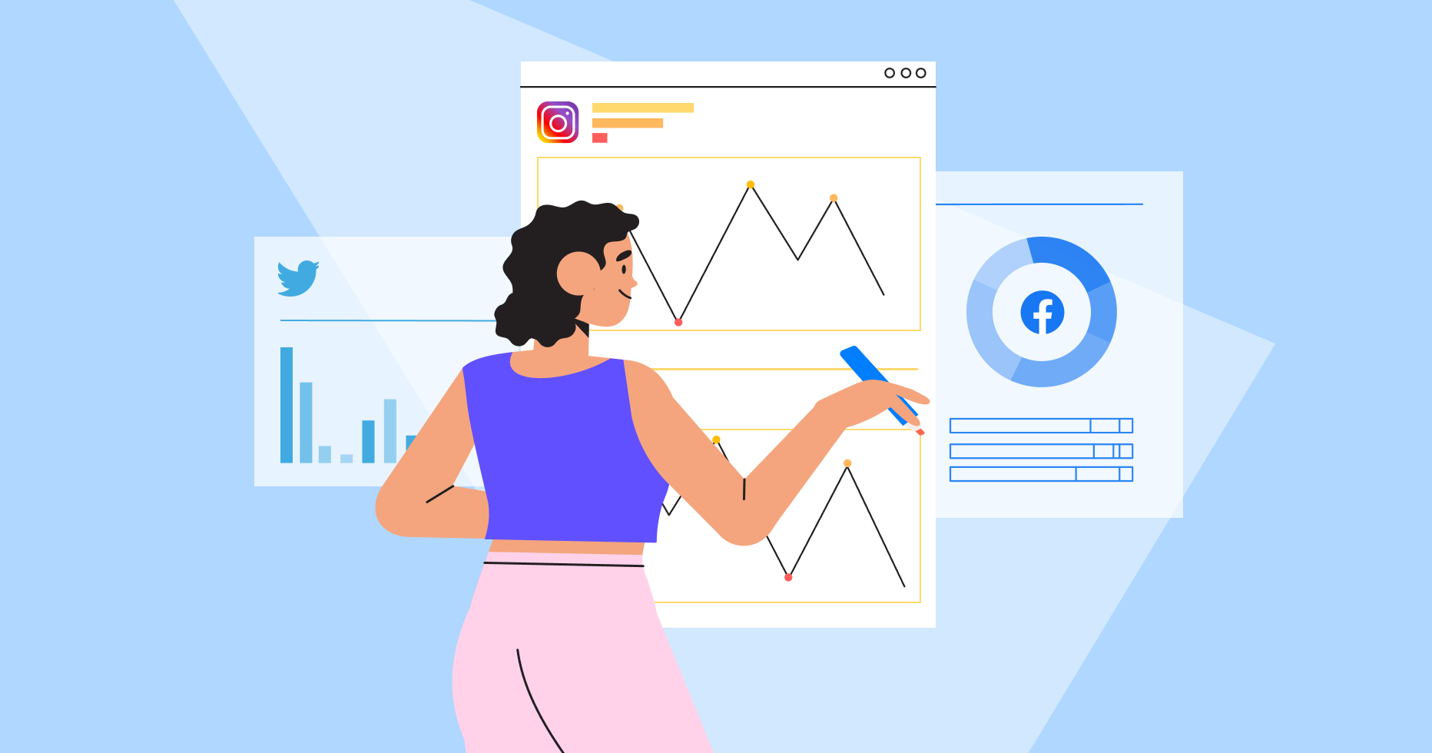
Approach
1. Understanding Problem Statement
5. Strategy Development
Designed actionable strategies to boost user retention and enhance engagement levels effectively.
Defined the core questions, set clear analysis goals, and identified the data required to address them.
6. Implementation Planning
2. Data Cleaning and Validation
Outlined steps to execute strategies for achieving optimized results and sustaining engagement improvements.
Processed the dataset by removing duplicates and handling null values to ensure data accuracy and reliability.
3. Data Analysis
4. Data Visualization
Leveraged advanced SQL techniques, including CTEs, aggregate functions, subqueries, groupings, and ranking functions, to extract meaningful insights.
Developed visual representations of key metrics such as total posts, likes, and comments.
Highlighted user rankings by engagement rates and showcased the impact of influential hashtags.

Slide 8
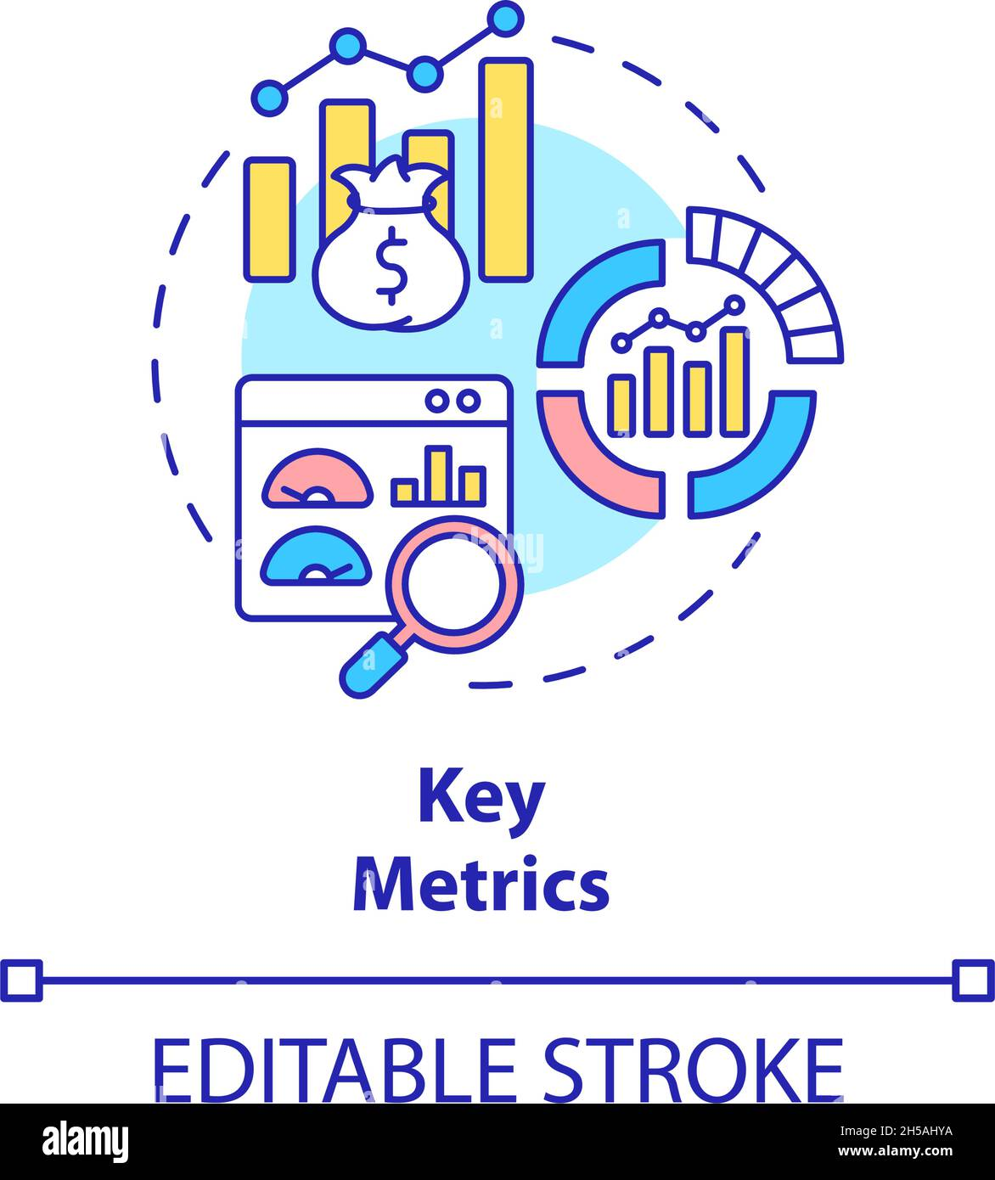
KEY MATRICS
Total Posts: Number of posts created by users.
Likes: Total number of likes received on posts.
Comments: Total number of comments on posts.
Engagement Rate: A calculated metric to assess user interaction with content (likes, comments, shares).
Top Hashtags: Most frequently used hashtags driving engagement.
User Rankings: Ranking of users based on their activity and engagement levels.
Retention Rate: Percentage of users consistently active over time.
Influential Users: Identification of users with the highest impact based on their engagement and reach.
By leveraging these metrics, we can effectively measure user engagement, segment users based on their activity levels, and design targeted strategies to address identified challenges and enhance overall engagement.

Slide 9
USER Classification
Out of 100 users there are only 30% of Active Users.
34 % of users are Moderate Active Users.
Inactive Users are the those users who have very low engagement rate and they are 36 %.
Top Performers: Jaylan Lakin and Aiyana Hoeger lead with 36% engagement.
Close Competition: Engagement rates range from 32% to 36%, showing a competitive group.
Insights: Top users significantly drive platform interactions.
Actionable Step: Focus on retaining and incentivizing these users.

Slide 10
Average Likes for Tags
Top-Performing Tags: Tags like "dreamy," "beauty," and "stunning" have the highest average likes, indicating strong audience appeal.
Engagement Insights: Tags associated with emotions (e.g., "happy") or visuals (e.g., "photography," "beach") consistently perform well.
Content Strategy: Focus on using top-performing tags to boost content visibility and engagement.
Opportunities for Improvement: Tags with lower average likes, such as "fashion" and "landscape," may require enhanced content alignment or targeting.

Slide 11
TOP engaged user based on likes comments and followers
Top Engagement: Janet.Armstrong leads with the highest engagement rate of 222, followed closely by Alexandro35 (220).
Key Metrics: Adelle96 and Alexandro35 achieved the highest likes (72), while Janet.Armstrong stands out with 154 comments.
Insight: High engagement rates are driven by a balance of likes and comments, emphasizing the need for interactive content strategies.

Slide 12
Likes Comments and Tags of each users
Top Engagement: Janet.Armstrong leads with the highest engagement rate of 222, followed closely by Alexandro35 (220).
Key Metrics: Adelle96 and Alexandro35 achieved the highest likes (72), while Janet.Armstrong stands out with 154 comments.
Insight: High engagement rates are driven by a balance of likes and comments, emphasizing the need for interactive content strategies.

Slide 13

Recommendation
Re-Engagement Strategies
Personalized Recommendations
Use Instagram Insights to analyze interests.
Create content tailored to user groups (age, location, interests).
Re-Engagement Emails
Send personalized emails showcasing missed trending content.
Suggest relevant content, groups, or hashtags.
Hashtag Targeting
Research and use popular, audience-specific hashtags.
Incorporate them into posts, stories, and ads.
Discounts & Gift Cards
Offer exclusive discounts or gift cards for user actions.
Use rewards to boost excitement and engagement.
Influencer Collaborations
Partner with influencers aligned with your brand values.
Track campaign performance using Instagram Insights.
User Contests
Run challenges with rewards for engaging content.
Encourage users to share and tag your brand.

Slide 14

Recommendation
Re-Engagement Campaigns
Identifying Inactive Users
Analyze user data to find inactive accounts.
Send personalized offers like discounts or exclusive features to re-activate them.
Leveraging Instagram Features
Use Stories, Reels, and polls to share engaging and trending content.
Highlight user-generated content or create interactive challenges.
Simplifying Content Creation
Provide templates or prompts to make posting easier.
Run seasonal challenges to encourage participation.
Engagement Programs
Offer rewards for consistent interactions, like badges or exclusive perks.
Partner with influencers to promote loyalty programs.
Custom Titles or Badges
Give users titles like “Top Contributor” to make them feel valued.
Use badges to reward milestones and motivate engagement.
Feedback Collection
Ask inactive users why they stopped engaging through DMs or polls.
Use their feedback to improve content and user experience.

Slide 15
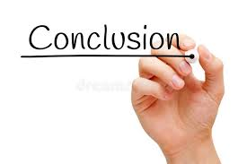
Conclusion
User Segmentation
Focus on three categories: Active, Moderately Active, and Inactive Users.
Prioritize Inactive Users for re-engagement strategies.
Hashtag Utilization
Monitor and use trending hashtags effectively to boost engagement.
Reels for Engagement
Promote reel creation among users, focusing on trending topics.
Collaborate with influencers to drive reel-based engagement.
Optimized Ads and Campaigns
Align ads and campaigns with current trends for better reach.
Promotions via Notifications
Use personalized notifications, email campaigns, and tests to re-engage users.

Slide 16
Acknowledgements and References
Acknowledgements:
I would like to express my gratitude to everyone who provided support throughout this project.
A special thanks to the online resources and communities that offered valuable insights and data.
I would also like to thank Newton School for their guidance and resources that significantly contributed to my understanding and execution of this project.
References:
Stack Overflow. (2023). Retrieved from https://stackoverflow.com
YouTube Tutorials on Data Analysis. (2023). Retrieved from YouTube

Slide 17


